Slide 1

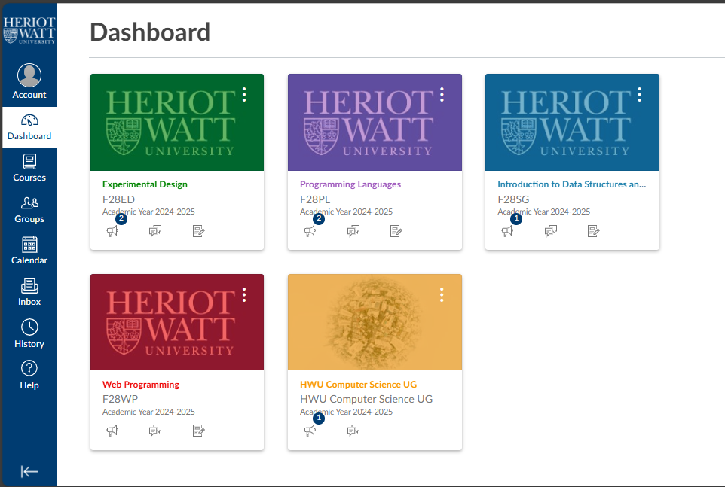

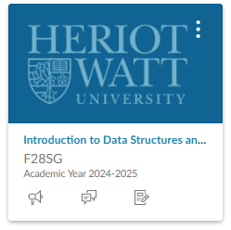
Payment
Log out
Contact info
Notes:
Student side

Slide 2
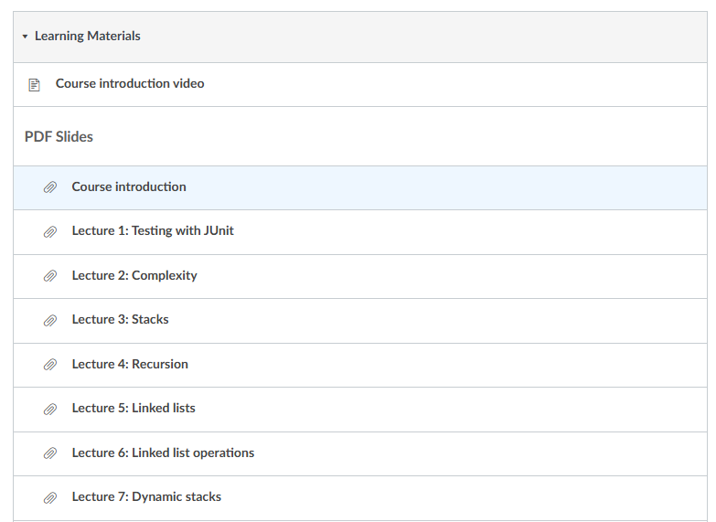
Contact info:
Email
number
subject
tutor name
Payment
Log out
Contact info
Notes:
Student side

Slide 3
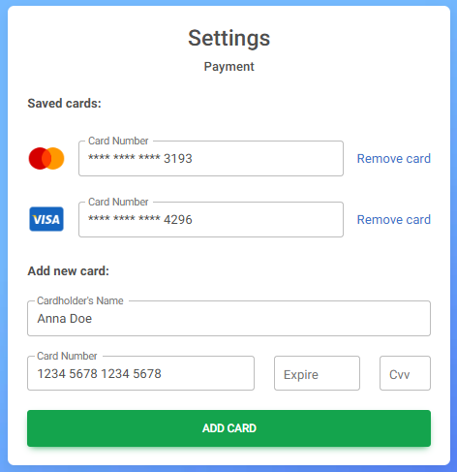
payment
Payment
Log out
Contact info
Notes:
Student side
Bootstrap Payment Forms: free examples, templates & tutorial

Slide 4
subjects
Log out
Contact info
Notes:
Tutor side

Slide 5
payments
Subject name
Student name | Subscription plain | Session done
bob | 10 | 2/10
sam | 5 | 4/5
tom | 1 | 0/1
Total for the month
Log out
1700 AED
Contact info
Notes:
Tutor side

